Slide 1
TELECOMMUNICATION INDUSTRY

Slide 2
KEY ASPECTS OF DATA
CUSTOMER BEHAVIOR & PREFERENCES
LOCATION-BASED DATA
VARIETY OF DATA
SECURITY

Slide 3


T-MOBILE
COMPANIES & THEIR RESEARCH
IBM RESEARCH
Customer Behavior Analysis
Network Optimization
5G Enhancements

Slide 4
DATA SCIENTIST
 | Data Manipulation and Analysis Machine Learning Statistical Modelling Database Management Cloud Computing
 | Data Collection and Cleaning Model Development and Performance Evaluation Collaboration with Network Engineers Documentation and Reporting Continuous Process
A
C
T
I
V
I
T
I
E
S
S
K
I
L
L
S
Notes:
Data scientists in telecom are like detectives. They gather and clean data to solve mysteries.

Slide 5
USE-CASES AND APPLICATIONS
01
02
CHURN PREDICTION
VOICE AND SPEECH ANALYTICS
03
04
PREDICTIVE MAINTENANCE
FRAUD DETECTION AND PREVENTIION
Notes:
We predict if someone might leave our service and try to make it better for them.

Slide 6
CHALLENGES
Customer Segmentation
Data Quality
Customer Churn
Privacy and Ethics
Pricing Strategies

Slide 7
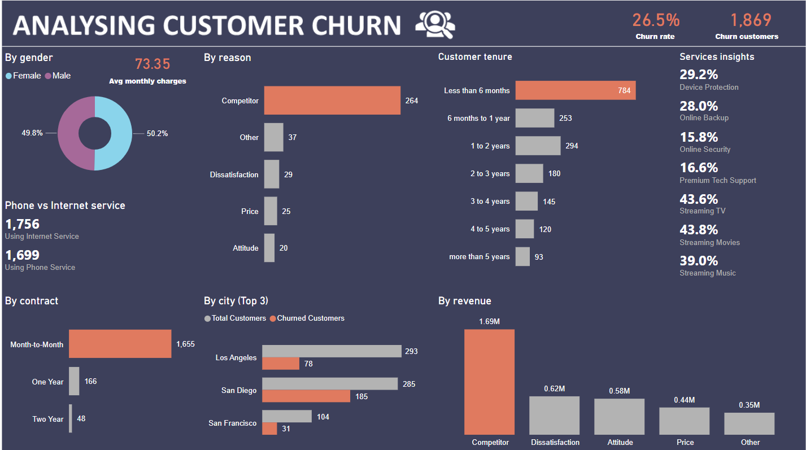

Slide 8
COURSES OFFERED BY CU BOULDER
ECEN 4242 – Communication Theory
CSCI 4622 – Machine Learning
CSCI 5922 – Neural Networks and Deep Learning
CSCI 5010 – Fundamentals of Data Communication

Slide 9

Thank You

